Slide 2
Introduction to SGSN and GGSN

Slide 3
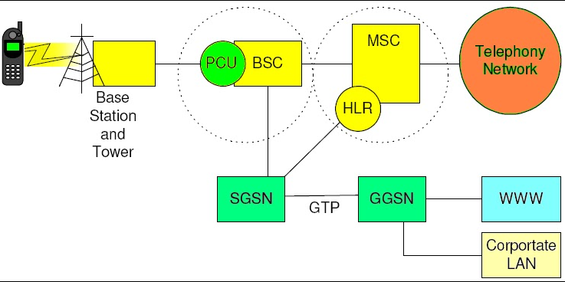
Introduction
SGSN and GGSN are two terminologies that started their journey in the late 1990s when General Packet Radio Service (GPRS) was introduced. SGSN and GGSN are two core network nodes that have been part of mobile communications since then.
GGSN (Gateway GPRS Support Node) and SGSN (Serving GPRS Support Node) are two core network nodes in 2G GSM and 3G UMTS networks that enable packet-switched mobile internet. GGSN and SGSN were added to GSM networks as part of the GPRS enhancement, and they are used by both GSM and 3G UMTS networks.

Slide 4
SGSN-Serving GPRS Support Node

Slide 5
What is SGSN
SGSN stands for Serving GPRS Support Node, and it is an essential core network node in GPRS networks that enables packet-switched mobile data (internet) in 2G GSM and 3G UMTS networks. SGSN works with GGSN and is responsible for mobility management, billing, and the management of data sessions.
SGSN is an essential network entity in GPRS (General Packet Radio Service), EDGE (Enhanced Data for Global Evolution) and 3G UMTS networks. SGSN (together with GGSN) was added to introduce the packet-switched technology within 2G GSM networks. In the overall 2G /3G mobile core network, SGSN can be seen as the “packet-switched” version of the MSC. So, just like the MSC utilises its circuit-switched capabilities to facilitate voice services, SGSN uses its packet-switched capabilities to facilitate data services. In the network architecture, SGSN sits between Radio Access Network (RAN) and Gateway GPRS Support Node (GGSN). It communicates with mobile phones through RAN and communicates with external networks through GGSN. That way, it allows our mobile phones to be able to connect to external networks

Slide 6
GGSN-Gateway GPRS Support Node

Slide 7
What is GGSN
GGSN stands for Gateway GPRS Support Node and it is a network node that connects SGSN (Serving GPRS Support Node) to external data networks such as the internet and X.25 for enabling packet-switched mobile data (internet) in 2G GSM and 3G UMTS networks. GGSN is part of the mobile core network.
GGSN is a network component that works closely with SGSN (Serving GPRS Support Node) and connects the core network in 2G GSM and 3G UMTS to external packet networks. The word ‘packet’ is important in this context because GGSN is all about packet-switched networks that enable mobile data. GGSN was added to the mobile core network as a gateway to connect the GPRS network to the external data world. From a network architecture point of view, GGSN is situated between the Serving GPRS Support Node (SGSN) and the external data networks such as the internet and X.25 networks

Slide 8
What Are SGSN And GGSN Used For?
SGSN and GGSN are used for connecting our cell phones to mobile internet through GPRS, EDGE, HSPA and HSPA+ technologies in 2G GSM and 3G UMTS networks. SGSN is the main node that performs packet-switching functions, whereas GGSN is more of a router that connects SGSN to the external data networks.
SGSN and GGSN are two essential nodes within the GSM and UMTS mobile core networks. These nodes allow us to access external networks such as the internet through our mobile phones when we are on 2G or 3G networks. The core network is central to the overall mobile network because it allows the subscribers of a mobile operator to access all the services that they are entitled to. The original GSM networks were mainly designed to support voice calls and SMS (text messages). Even though technologies like Circuit-Switched-Data (CSD) and High-Speed Circuit-Switched Data (HSCSD) could technically enable data, it was not the best use of network resources by engaging dedicated circuits for data sessions. That is where the General Packet Radio Service (GPRS) enhancement came in with its packet-based approach. As part of the GPRS enhancement, a packet-switched part was introduced into the core network architecture of GSM by adding two new nodes. These nodes are called the Serving GPRS Support Node (SGSN) and Gateway GPRS Support Node (GGSN). Later, the 3G UMTS networks also followed the same approach and continued with separate circuit-switched and packet-switched network entities that included SGSN and GGSN. 4G LTE networks, however, use a more advanced mobile core network called the EPC or Evolved Packet Core.

Slide 9
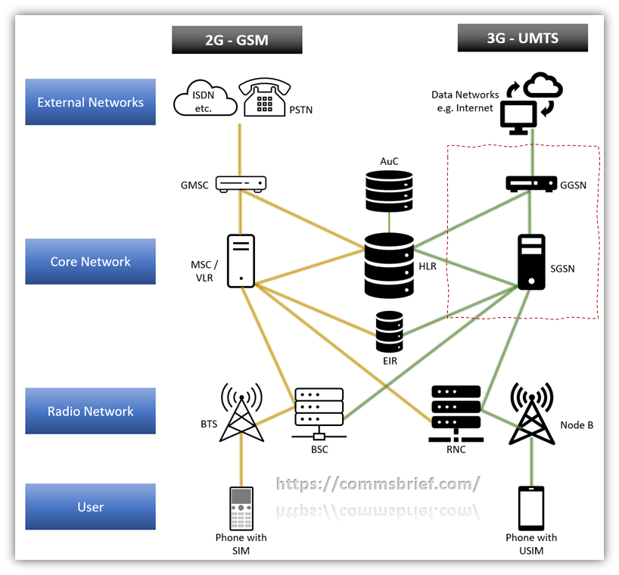
SGSN and GGSN in a 2G/3G (GSM/UMTS) network

Slide 10
SGSN And GGSN In 4G LTE Networks
4G LTE networks do not have SGSN and GGSN, but they use equivalent network nodes that offer the packet-switching capability in 4G. LTE networks are fully packet-switched and use Serving Gateway (S-GW) as the equivalent of SGSN and Packet Data Network Gateway (PDN-GW) as the equivalent of GGSN.
SGSN and GGSN network nodes only exist in GPRS, EDGE and UMTS networks. The 4G LTE mobile core network, Evolved Packet Core (EPC), consists of different network entities that perform the packet-switched tasks. The equivalent of SGSN in LTE is Serving Gateway (S-GW), as shown in the network diagram below. The equivalent of GGSN in LTE is Packet Data Network Gateway (PDN-GW). 4G LTE networks only use packet-switched technology which is why you cannot see the circuit-switched representation in the 4G LTE network architecture below. 4G LTE networks however have a circuit-switch fallback option that utilises the 2G GSM and 3G UMTS networks to facilitate circuit-based voice calls and SMS. Since the future of voice and SMS is all data, LTE networks have a capability called Voice over LTE (VoLTE) that allows packet-switched LTE networks to enable IP based voice calls and SMS. 5G networks have an equivalent technology, Voice over New Radio (VoNR) that enables voice calls and SMS through the 5G core network

Slide 11
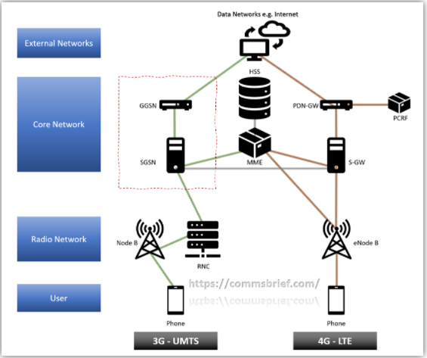
SGSN and GGSN in a 3G/4G (UMTS/LTE) mobile network

Slide 12
Thank you !

